Slide 1

Shree Swaminarayan College of Computer Science (Affiliated to M.K Bhavnagar University)
PROJECT PRESENTATION
ON
[Doctor’s Appointment System]
Guided By :
Submitted By :
GAURANG BHATT
[25260038] MR. DHRUMIL D BHALANI
[25260224] MR. UTSAV P SALIYA

Slide 2
BACKGROUND
The doctor appointment system is to provide patients or any user an easy way of booking a doctor’s appointment online.
According to us we find that today population and less availability of doctor's large number of patients unable to reach ones to doctor that we developed this project.
Patient can be easily to take appointments and also its information successfully registered within particular requirements.
The doctor appointment system managing the details of doctors, appointment, patient, doctor schedule etc.
The online doctor appointment system reduces the manual work for managing the doctor, appointment, patient etc.

Slide 3
OBJECTIVE OF SYSTEM
The doctor appointment system has been created because the problem that we are facing should be reduced to the patients and doctors in the clinic systems.
The vision of the website application to give benefit to doctor and patient to reduce manual work.
No knowledge is required for the user to use this system and also it is user-friendly.
Helping people to search for doctors and get appointment is our main objectives. User can search doctors which can make sure to find specific doctor with an easy task.
The doctor will able to see all their appointments, which are appoint to patients at this online platform.

Slide 4
PURPOSE
Planned approach towards working: -
The working in the hospital will be well planned and organized. The data will be stored properly in data stores, which will help in retrieval of information as well as its storage.
Accuracy: -
The level of accuracy in the system can be decided. Because here user take appointment and another user get appointment.
Reliability: -
The reliability of the system will be high due to the above stated reasons. The reason for the increased reliability of the system is that now there would be proper storage of information.

Slide 5
SCOPE
The real of world wide web have spread across millions of households, so naturally, internet has become by far the platform for appoint the doctor today.
As a rapid change of an information technology, now hospital industry also needs to enhance that patient record and make it highly confidential.
There are lots of hospitals and clinics, who advertise online so idea behind development this application is that users\patients can take doctor’s appointment online.
This website is an online doctor appointment through admin can maintain medical specialists, add doctor, appointment list page, users page, feedback review, system settings and also access its information and manage all the adding, updating, deleting the medical specialists and some of its tasks.

Slide 6
PLANNING & SCHEDULING
ACTIVITY | TIME DURATION
Requirement Analysis | 2 Week
Planning Risk | 2 Week
Designing | 2 Week
Coding | 3 Week
Testing | 1 Week
Documentation | 2 Week

Slide 7
PROBLEM DEFINATION
In the present system all work is done on paper. It takes long process to get the appointments of the doctors. Patients need to go to the hospital and get the appointments of the doctors which will consume patient’s time and money.
In existing situation, people stand in long queues and still people have no appointment? That happens when you choose offline appointments.
Whereas in online appointment is easy and also less hectic. People can book doctor appointment 24X7 at anywhere.
With the world running fast, no one really waits for anyone else, people things to happen quickly and offline appointment take lot of time.

Slide 8
SOFTWARE REQUIREMENT
ITEM | VERSION
Browser | Google Chrome, Mozilla Firefox, Internet Explorer.
Operating System | Windows 7 & above.
Front-End | PHP [5.6]
Back-End | MYSQL [5.7]
Software | WampServer [3.2.3], Xamppserver [7.4.28-0], Notepad++ [8.2.1].
Design | HTML [4.01], CSS [3], JavaScript [ES6], jQuery [3], Bootstrap [5].

Slide 9
HARDWARE REQUIREMENT
ITEM | MINIMUM REQUIREMENT | RECOMMANDED
RAM | 4GB | 8GB
Processor | Intel-I3 | Intel-I5
Hard-disc Space | 80GB | 80GB & above.

Slide 10
DATA FLOW DAIGRAM

Slide 11
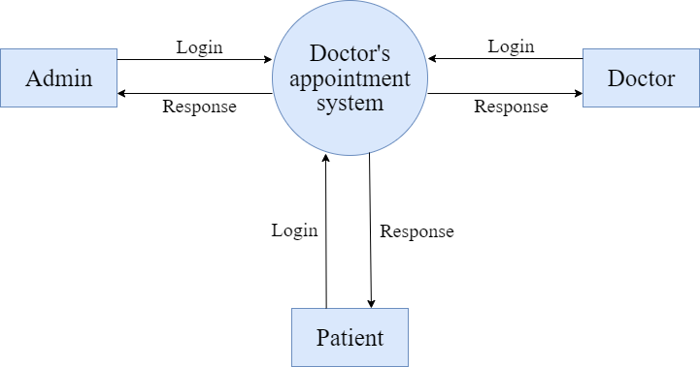
DFD :- CONTEXT LEVEL [DATA FLOW DAIGRAM]

Slide 12
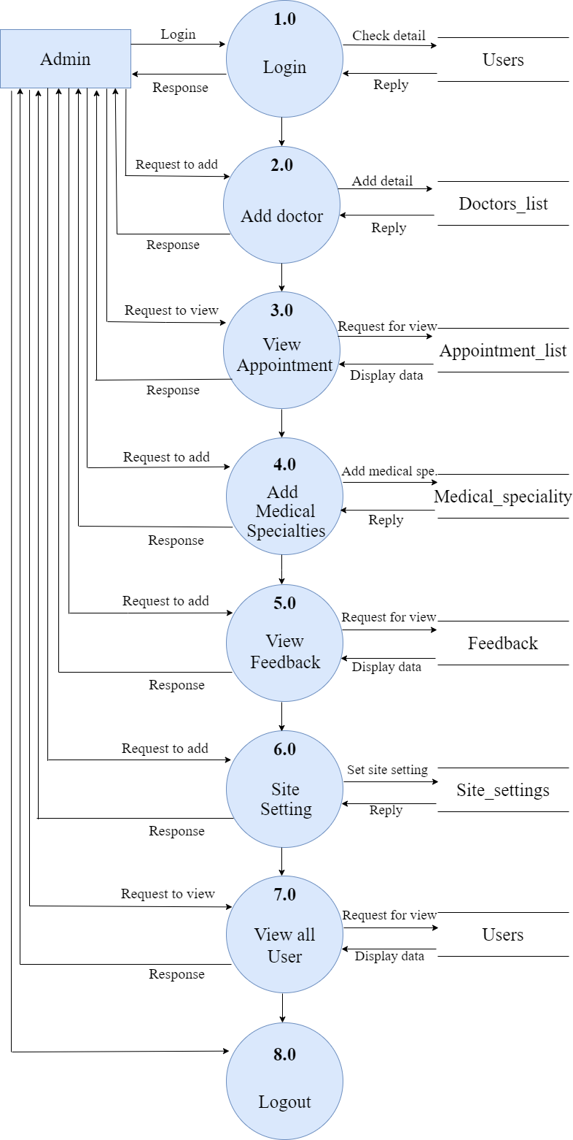
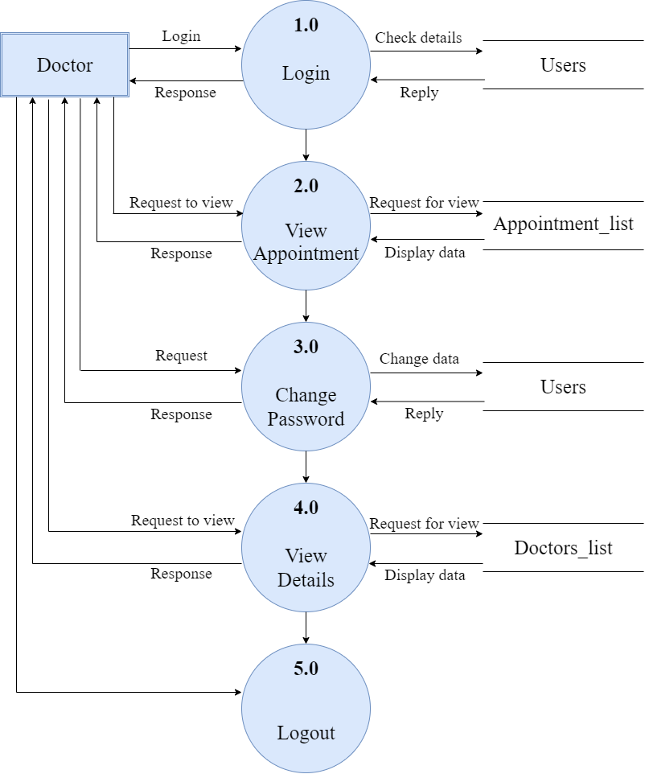
DFD :- LEVEL 1 [ADMIN SIDE]
DFD :- LEVEL 1 [DOCTOR]

Slide 13
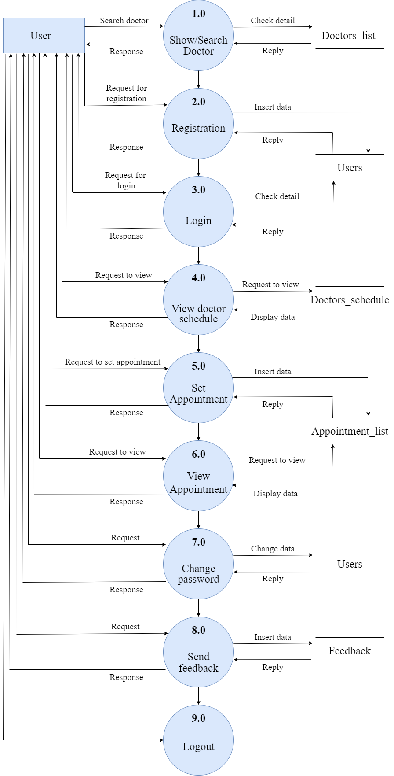
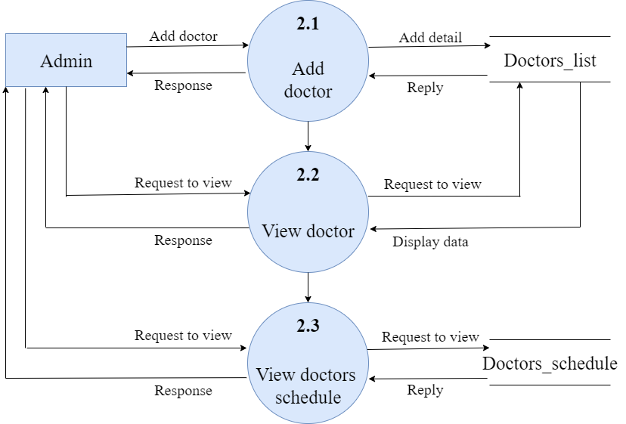
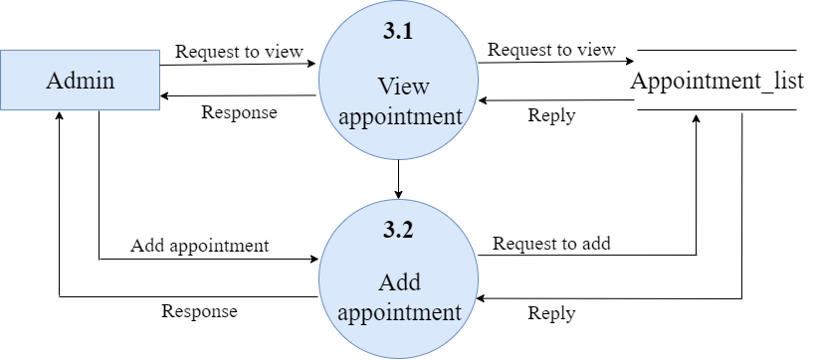
DFD :- LEVEL 1 [PATIENT]
DFD :- LEVEL 2 [ADMIN SIDE]
ADMIN SIDE [2.0]
ADMIN SIDE [3.0]

Slide 14
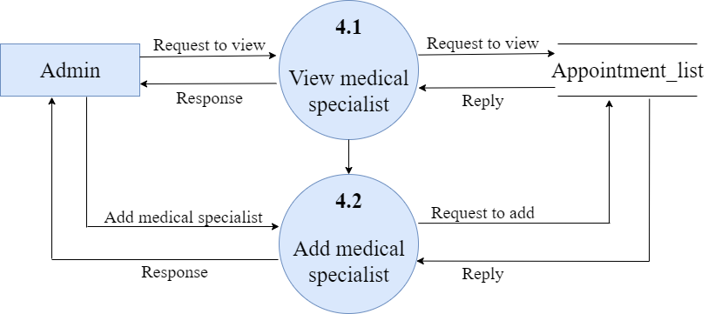
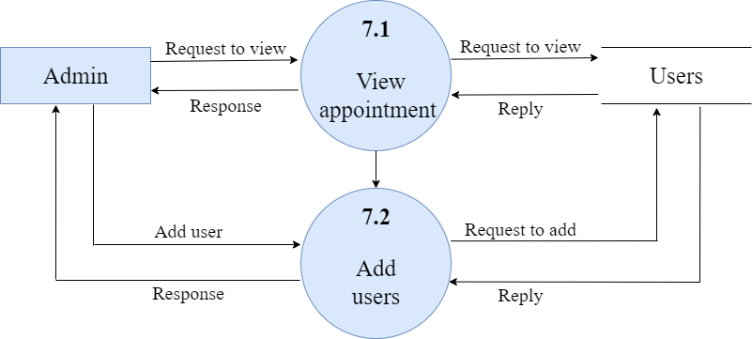
ADMIN SIDE [4.0]
ADMIN SIDE [7.0]

Slide 15
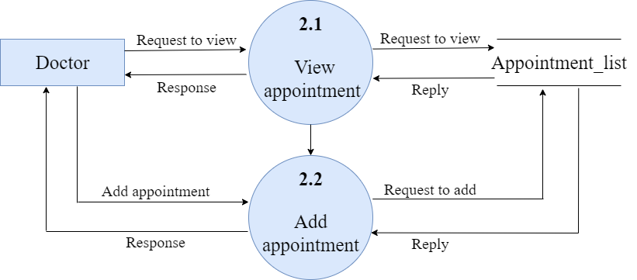
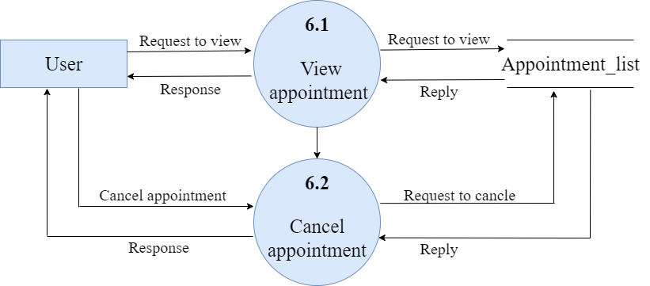
DFD :- LEVEL 2 [DOCTOR]
DOCTOR SIDE [2.0]
DFD :- LEVEL 2 [PATIENT]
PATIENT SIDE [6.0]

Slide 16
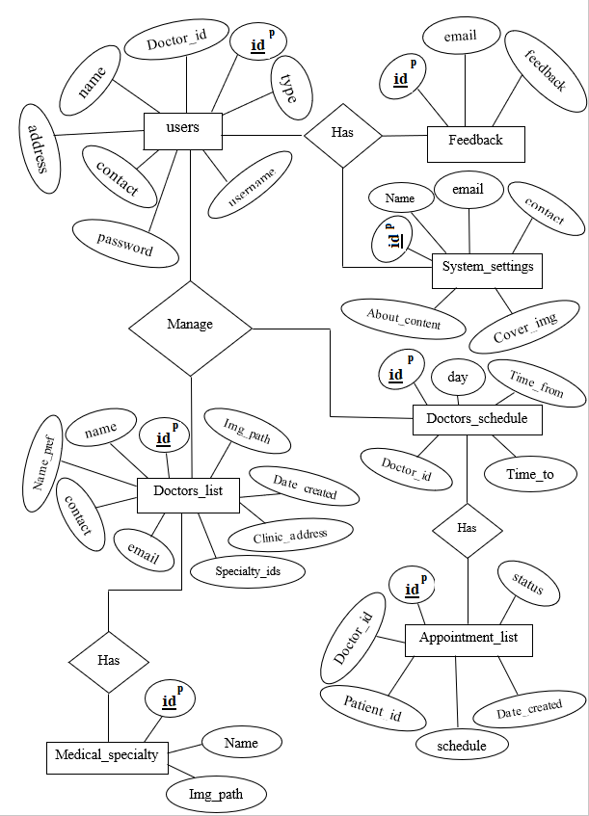
E-R DAIGRAM : -

Slide 17
DATA DICTIONARY

Slide 18
TABLE 1 : - medical_specialy
Sr no. | Field Name | Data Type | Size | Constrain | Description
1 | id | int | 5 | Primary key | Id of medical specialties
2 | name | text | 30 | Not null | Name of specialties
3 | img_path | text | 90 | Not null | Image path for medical specialties

Slide 19
TABLE 2 : - doctors_schedule
Sr no. | Field Name | Data Type | Size | Constrain | Description
1 | id | int | 5 | Primary key | Id of schedule
2 | doctor_id | text | 5 | Not null | Id of doctor
3 | day | text | 10 | Not null | Day of week
4 | time_from | time | - | Not null | Start time of schedule
5 | time_to | time | - | Not null | End time of schedule

Slide 20
TABLE 3 : - feedback
Sr no. | Field Name | Data Type | Size | Constrain | Description
1 | id | int | 5 | Primary key | Id of feedback
2 | email | varchar | 30 | Not null | E-mail id of end user
3 | feedback | varchar | 200 | Not null | Review from user

Slide 21
TABLE 4 : - doctors_list
Sr no. | Field Name | Data Type | Size | Constrain | Description
1 | id | int | 5 | Primary key | Id of doctor
2 | name | varchar | 30 | Not null | Name of doctor
3 | name_pref | varchar | 5 | Not null | Prefix of doctor
4 | clinic_address | varchar | 35 | Not null | Address of clinic
5 | contact | varchar | 14 | Not null | Contact of doctor
6 | email | varchar | 30 | Not null | E-mail of doctor
7 | specialty_ids | text | 10 | Not null | Id of medical specialties
8 | img_path | varchar | 90 | Not null | Path of doctor image
9 | date_created | datetime | - | Not null | Date when created account.

Slide 22
TABLE 5 : - appointment_list
Sr no. | Field Name | Data Type | Size | Constrain | Description
1 | id | int | 5 | Primary key | Id of appointment
2 | doctor_id | int | 5 | Not null | Id of doctor
3 | patient_id | int | 5 | Not null | Id of pattient
4 | schedule | datetime | - | Not null | Date & time of patient appointment
5 | status | tinyint | 1 | Not null | 0 = pending requiest, 1= confirm, 2 = reschedule, 3 = cancle
6 | date_created | datetime | - | Not null | Date when a patient take appointment of doctor.

Slide 23
TABLE 6 : - users
Sr no. | Field Name | Data Type | Size | Constrain | Description
1 | id | int | 5 | Primary key | Id of user
2 | doctor_id | int | 5 | Not null | Id of doctor
3 | name | varchar | 30 | Not null | Name of user
4 | address | varchar | 35 | Not null | Address of user
5 | contact | varchar | 14 | Not null | Contact of user
6 | username | varchar | 20 | Not null | Username of user
7 | password | varchar | 10 | Not null | Passord of user
8 | type | tinyint | 1 | Not null | 1 = Admin, 2 = Doctor, 3 = User [Patient]

Slide 24
TABLE 7 : - system_settings
Sr no. | Field Name | Data Type | Size | Constrain | Description
1 | id | int | 5 | Primary key | Id of system setting
2 | name | varchar | 30 | Not null | Name of the system
3 | email | varchar | 30 | Not null | E-mail for contact & user
4 | contact | varchar | 14 | Not null | Contact of end user
5 | cover_img | text | 30 | Not null | Image path of cover image
6 | about_content | text | 900 | Not null | Content of about page

Slide 25
INPUT – OUTPUT DESIGN

Slide 26
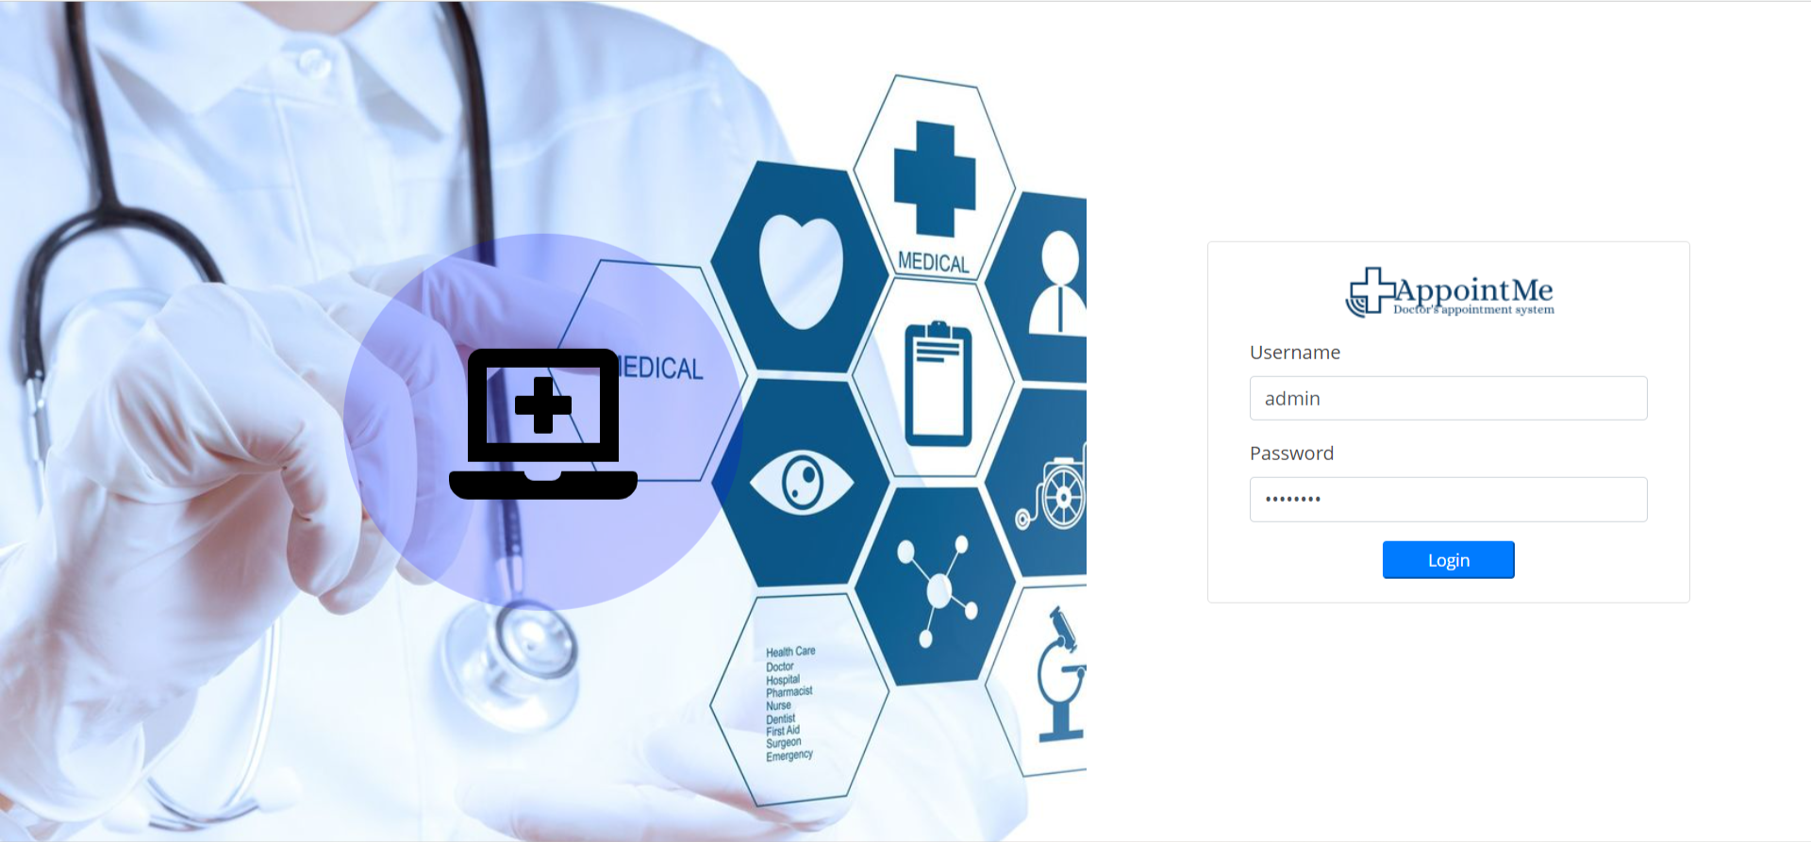
ADMIN INTERFACE DESIGN
ADMIN PAGE : -
Admin login in doctor’s appointment System to update or delete the appointment.
Admin login to manage all System Information.
All user and doctor Details and Information.

Slide 27
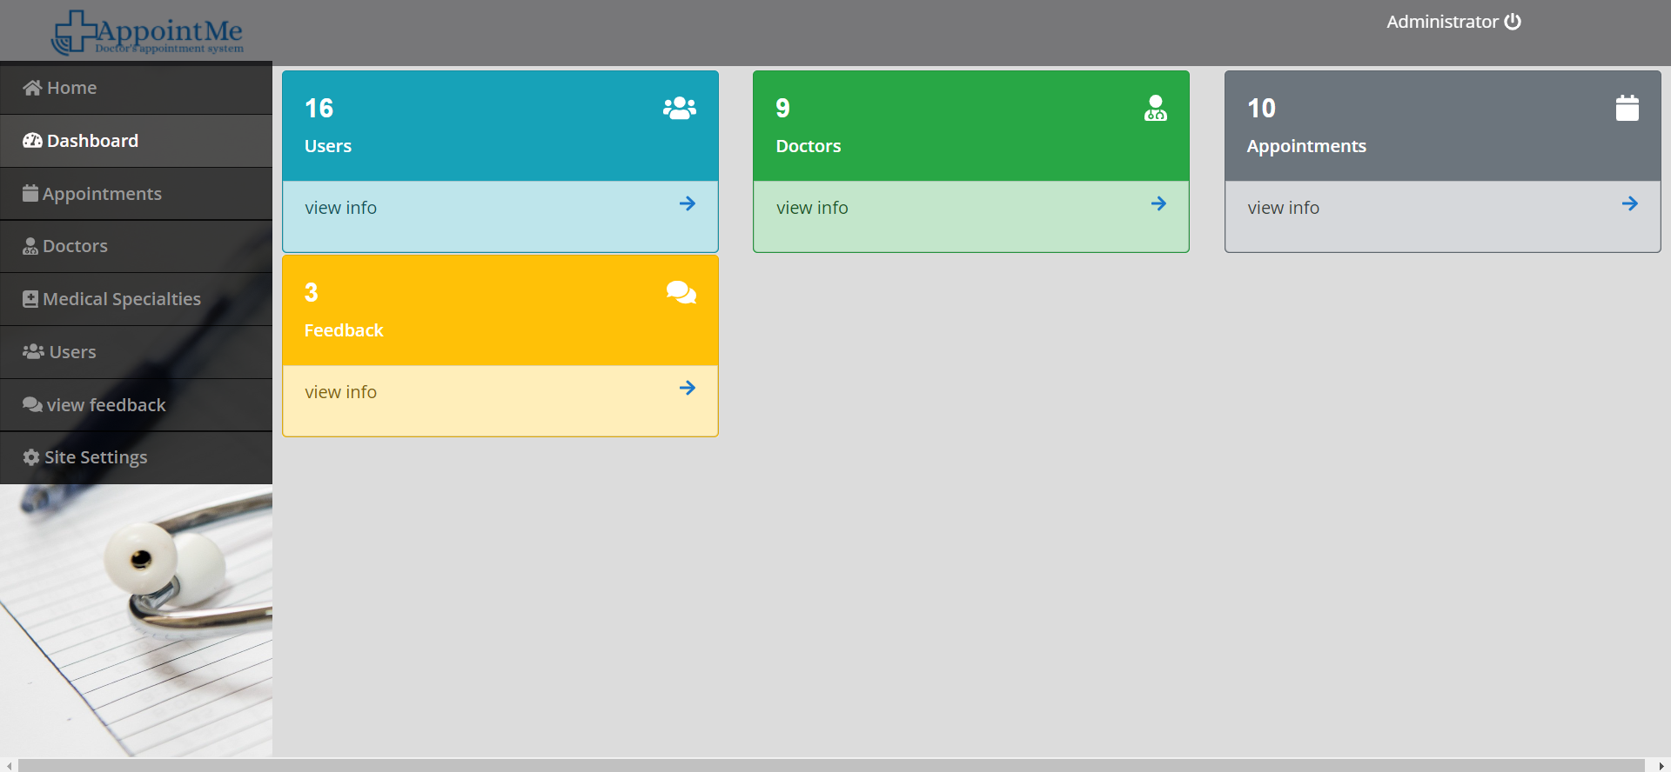
DASHBOARD PAGE : -
in dashboard page that display total number of users, doctor, appointment and also feedback.
Admin can also view specific pages from this page by click on arrow.

Slide 28
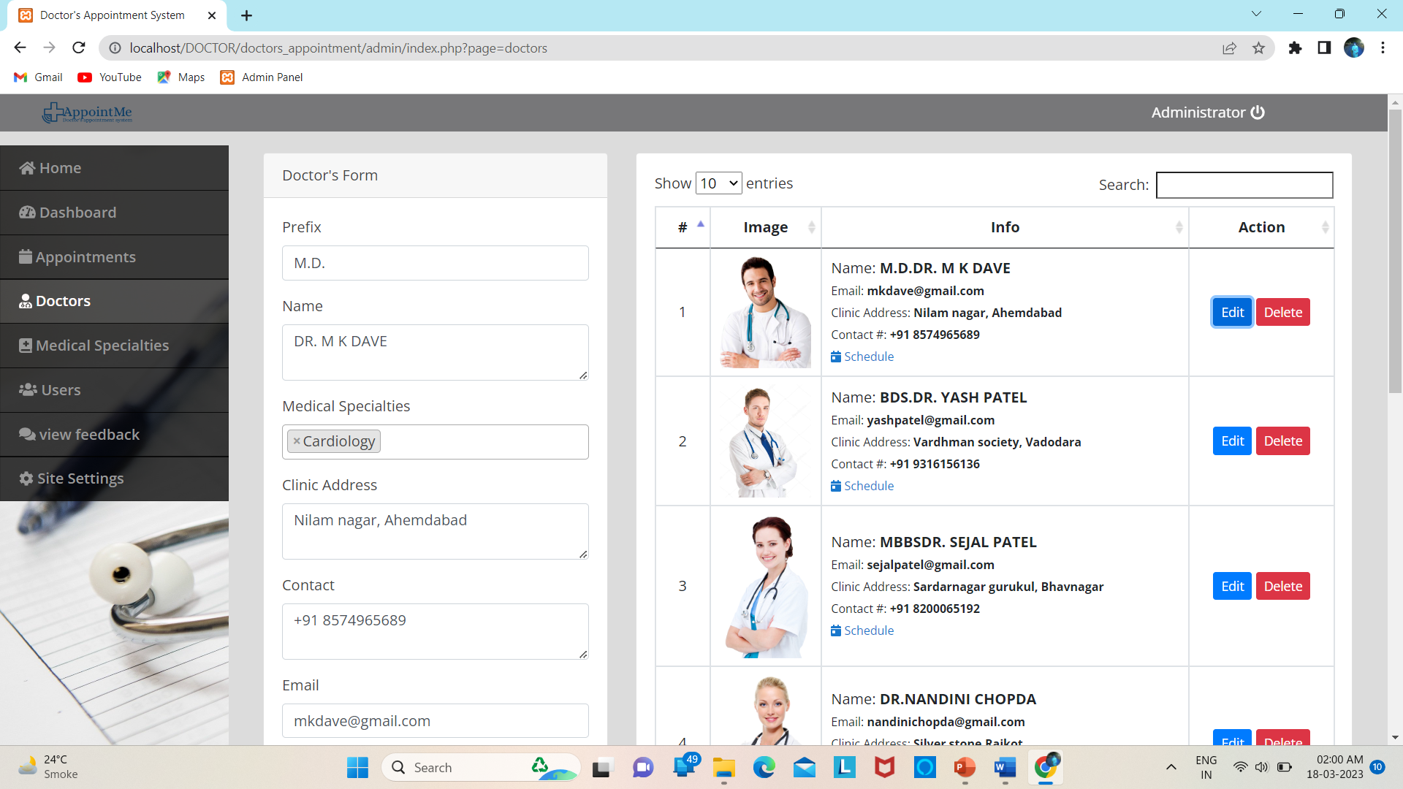
ADD DOCTOR : -
Admin can add, update, delete doctor information like name, address, specialty, email and password etc.,

Slide 29
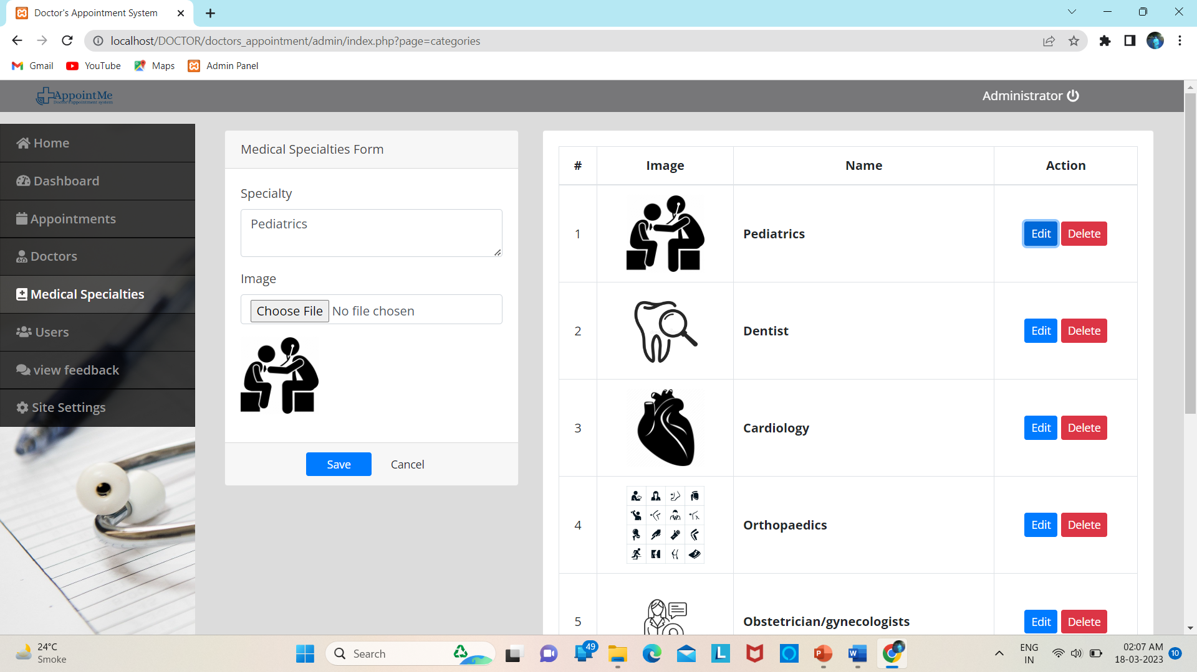
ADD MEDICAL SPECIALTIES : -
Medical specialties in doctor’s appointment system that add, update or delete medical specialty like cardiology, audiology, dentist etc.,

Slide 30
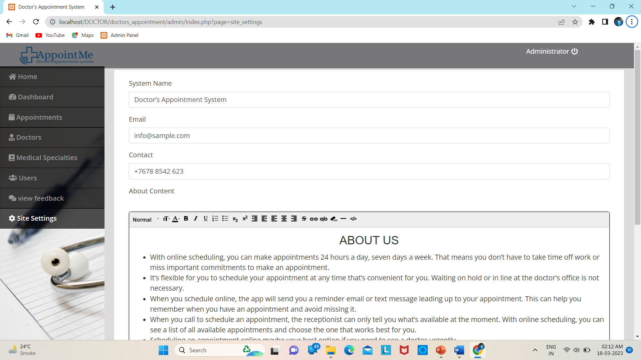
SYSTEM SETTING PAGE : -
In system setting admin can set mail id, contact, about us content of system and also set cover image for user side.

Slide 31
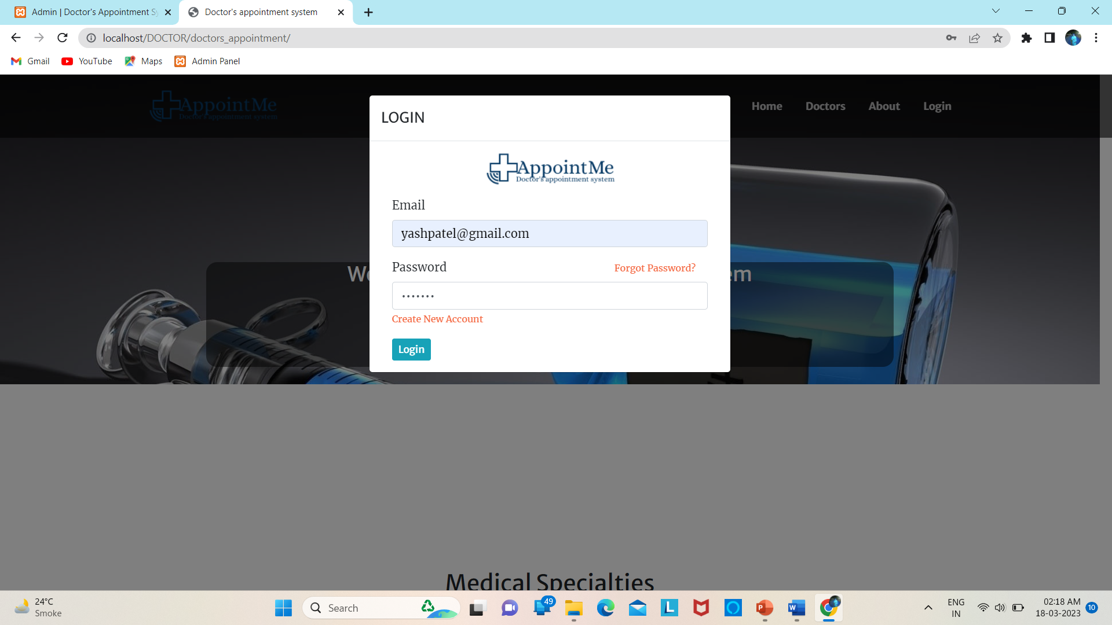
DOCTOR INTERFACE DESIGN
LOGIN PAGE : -
In this login page doctor and also patient can log into their side by enter E-mail and its password.
When doctor or patient logged into the system, they redirect to their home page.

Slide 32
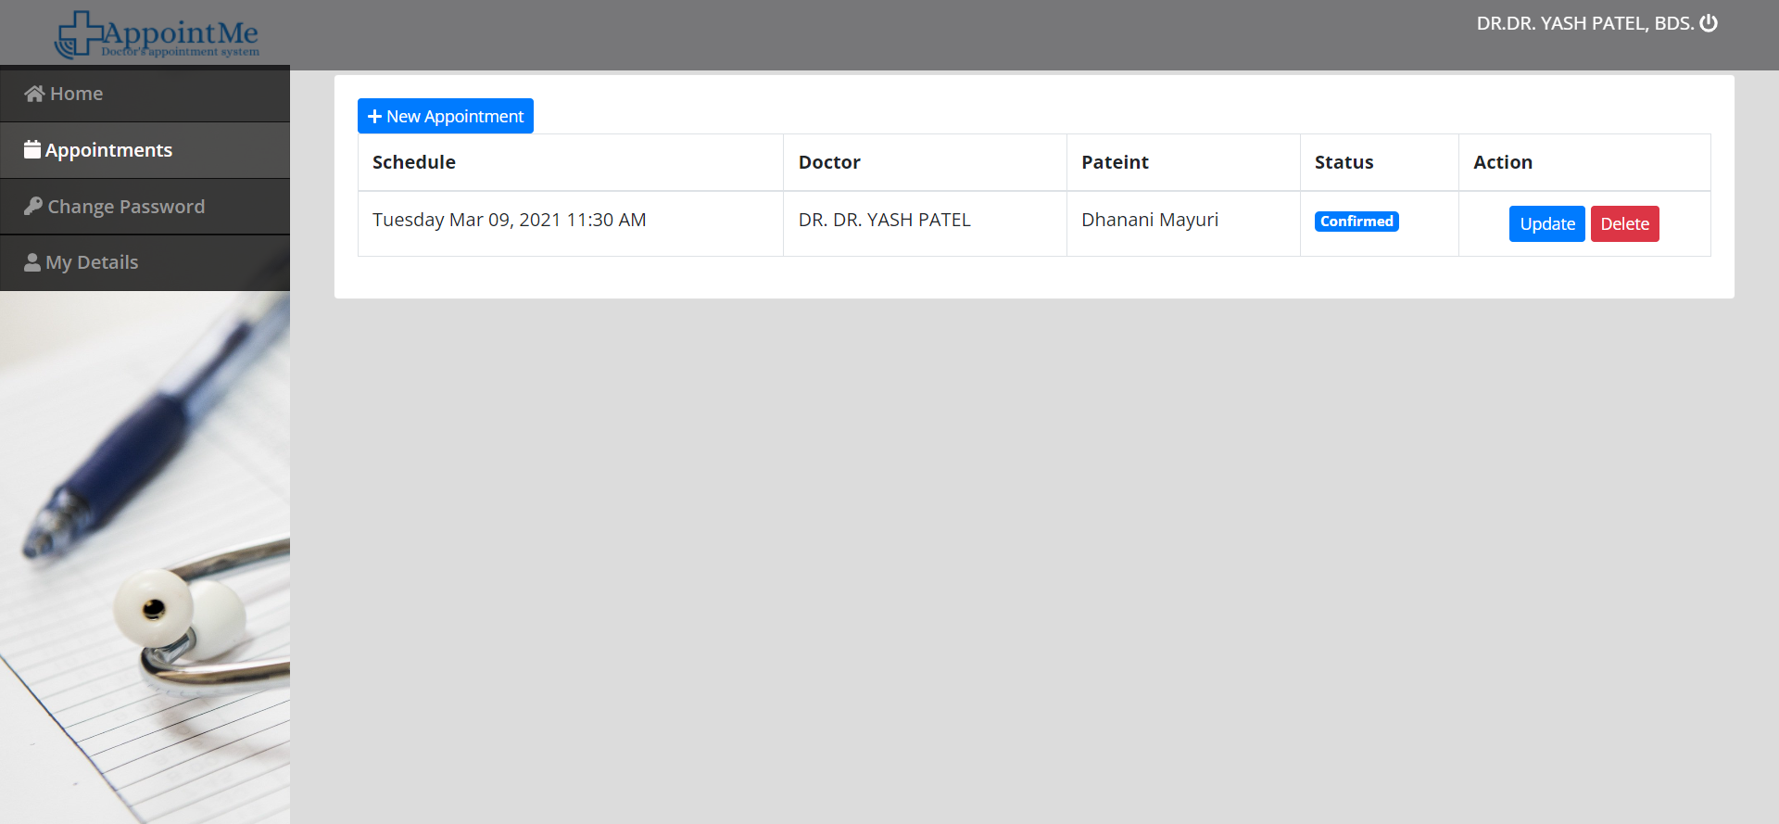
APPOINTMENT LIST PAGE : -
In appointment page doctors can view particular appointments taken by patients.
doctors can cancel, rescheduled or confirm patient or end user request.

Slide 33
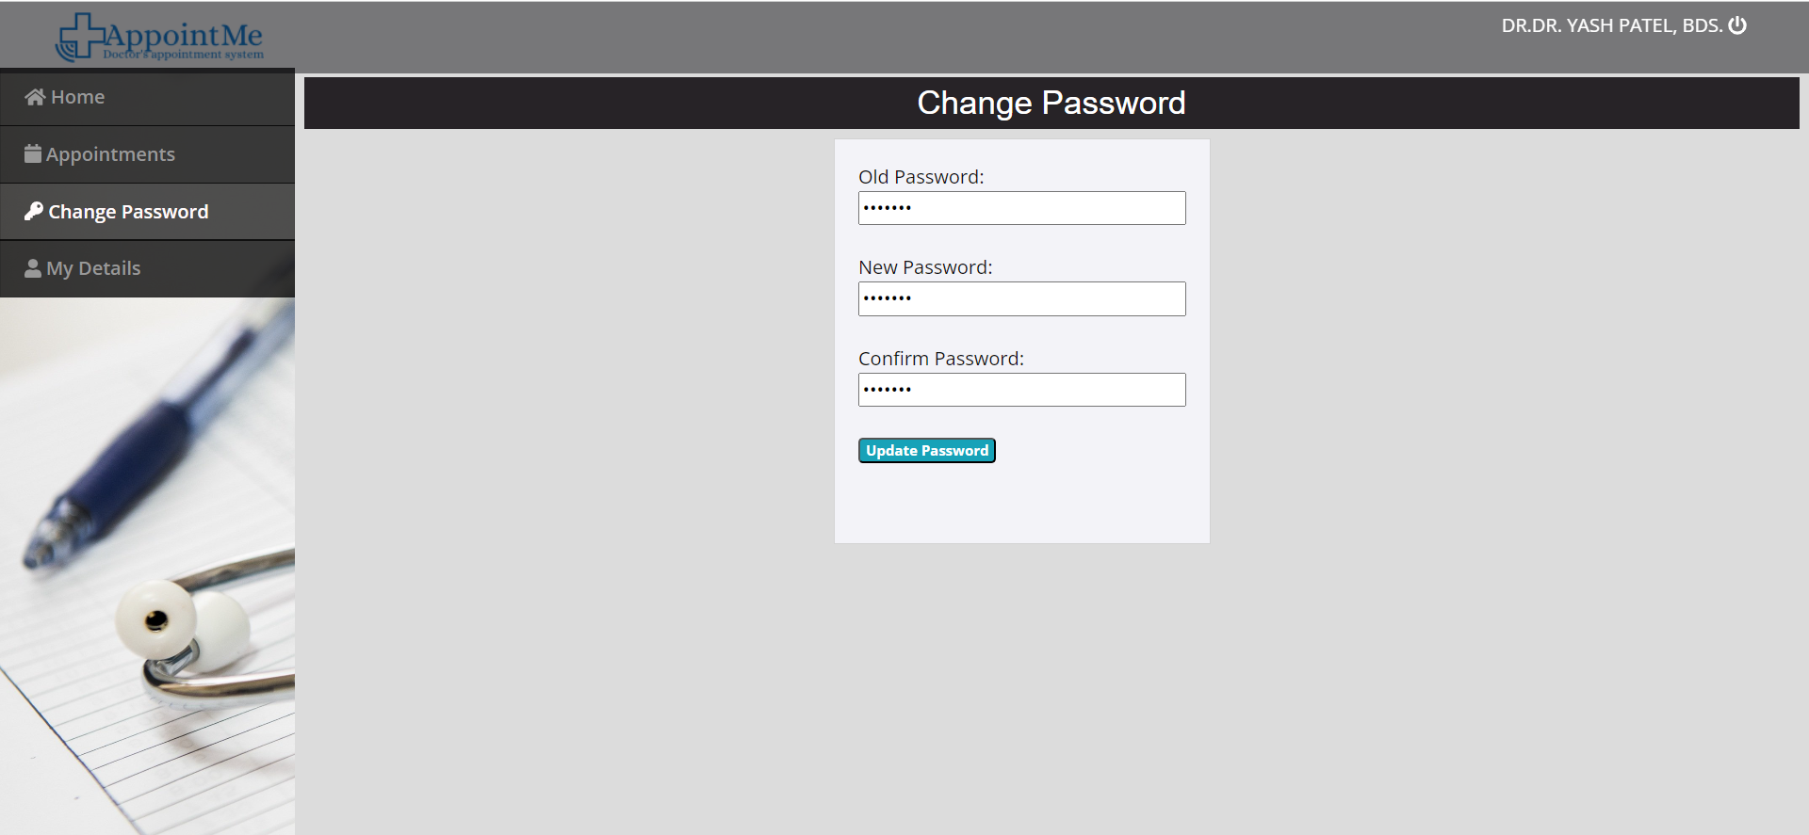
CHANGE PASSWORD PAGE : -
In change password page doctors enter their old password as well as new password and confirm password and new password or confirm password both are same and then click on update button so that doctor can change password.

Slide 34
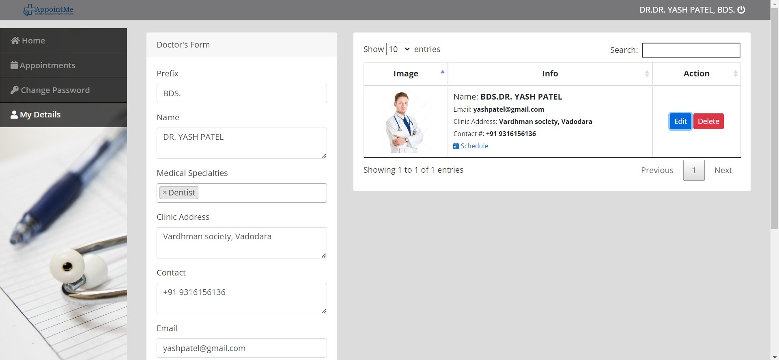
DOCTORS DETAILS PAGE : -
In this page doctors see their detail like name, profile picture, address, mobile number, email id and also schedule etc., he/she also update information by click on update button.

Slide 35
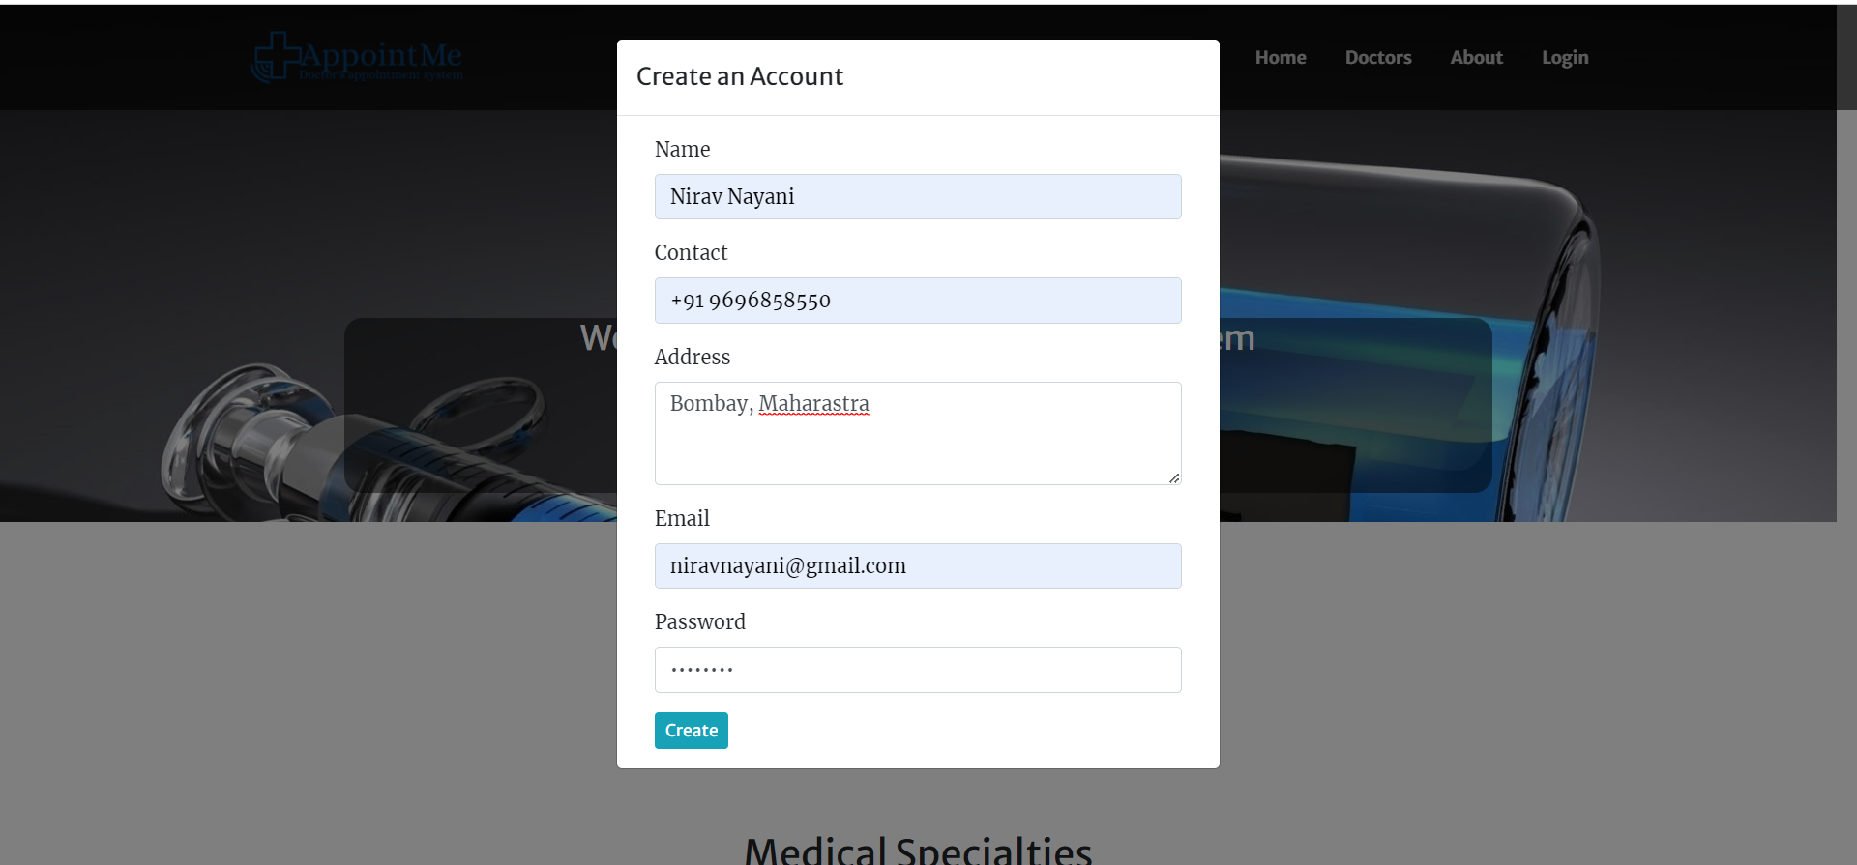
PATIENT INTERFACE DESIGN.
REGISTRATION PAGE : -
In registration page end user fill up all the information such as name, contact, address, E-mail, password etc., and then click on create button to create a new user of the system.

Slide 36
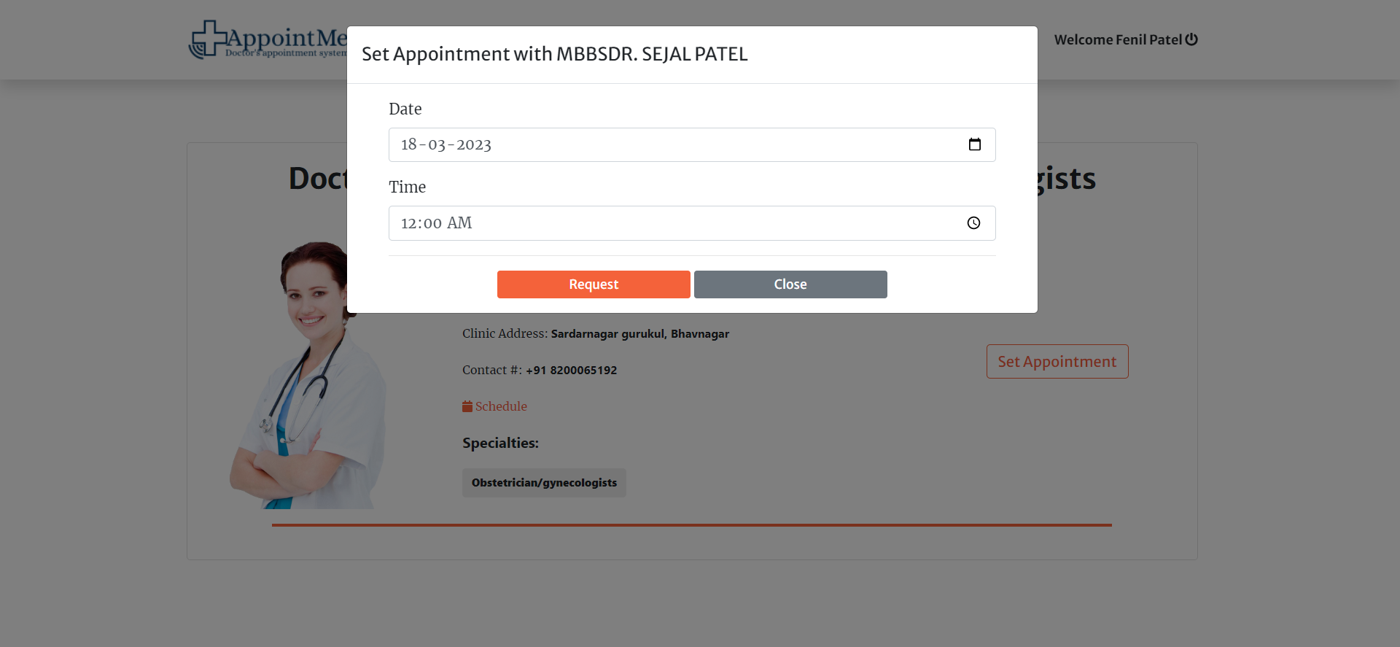
SET APPOINTMENT PAGE : -
End user enter date and time according to particular doctor’s schedule and set appointment with doctor as request submit by patient to take appointment to doctor.
Only register users can set appointment with doctor. If user not register then first register and then take appointment with doctor.

Slide 37
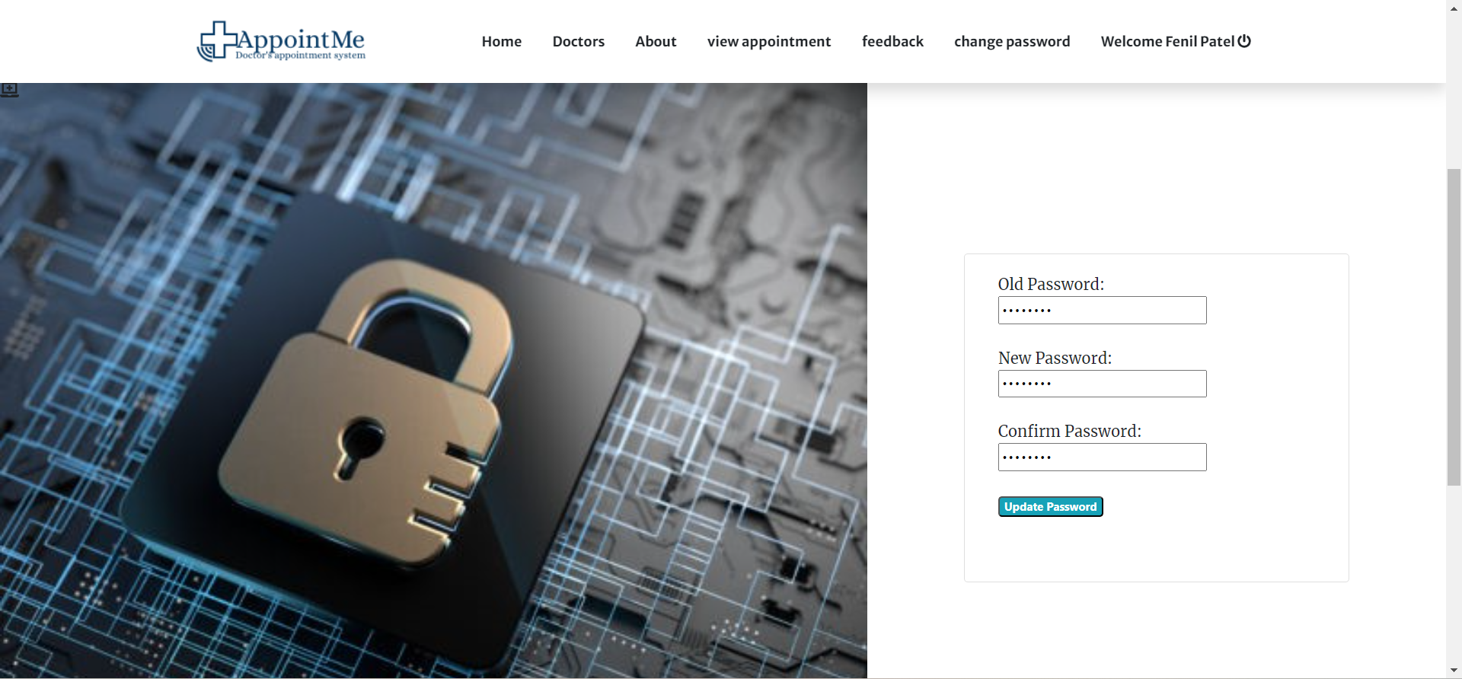
CHANGE PASSWORD PAGE : -
In change password page user can be easily to change his/her password.
In change password page End users enter their old password as well as new password and confirm password and click on update button so that End user can change password.

Slide 38
TEST CASE

Slide 39
TEST CASE : - 1
Test Case id | 1
Name | Valid backend Admin login to enter his Username and Password.
Description | This test case will check and allow administrator to log-in to system / the backend of system.
Input Data | Enter valid Username. Enter valid Password.
Test Data | Username = admin Password = admin123
Expected Output | System needs to check if username and password is valid into system MySQL database: - Case 1: If username and password are match and found from database then allow to access system (by forwarding to Home screen). Case 2: If username and password does not match in database then give message “username or password is incorrect”.
Actual Output | System Allows admin to login because Username and Password is correct.
Pass / Fail | PASS

Slide 40
TEST CASE : - 2
Test Case id | 2
Name | Valid doctor detail.
Description | This test case will allow to make sure to add/edit/delete valid doctor detail by logged in user in backend.
Input Data | Enter valid doctor prefix. Enter valid doctor name. Select valid medical specialty. Enter valis doctor clinic address. Enter valid contact. Enter valid email address. Enter valid password. Upload valid doctor image.
Test Data | Prefix=Dr., Name=abc, Medical specialty=cardiology, Address=gabani chowk, vallabhipur, Contact=+91 9316156136, Email=abc@gmail.com, Password=abc123.
Expected Output | Admin fill-up doctor information and click on save button all information display into right side of page also in doctors page of user side, and doctors view their particular information and also edit it.
Actual Output | System allow user to store detail into system database.
Pass / Fail | PASS

Slide 41
TEST CASE : - 3
Test Case id | 3
Name | Valid medical specialty detail.
Description | This test case will allow to make sure to add/edit/delete valid medical specialty type by logged in user in backend.
Input Data | Enter specialty name. Upload specialty image.
Test Data | Specialty Name = Cardiology
Expected Output | Medical specialty name is compulsory/required. Image can be optional. Admin fill-up medical specialty information and click on save button all information display into right side of page also in home page of user side. System allow user to store detail into system database.
Actual Output | System allows to store medical specialty detail into system database.
Pass / Fail | PASS

Slide 42
TEST CASE : - 4
Test Case id | 4
Name | Valid doctor schedule.
Description | This test case will allow to make sure to add/edit valid medical doctor schedule by logged in user in backend.
Input Data | Enter weekly time.
Test data | Day=Monday, Time to=8:00 AM, Time from=5:30 PM.
Excepted Output | Schedule is compulsory/required. Admin and also doctor add schedule and click on save button schedule display with doctor information also in doctor page of user side. System allow user to store schedule into system database.
Actual Output | System allows to store doctors schedule detail into system database.
Pass/Fail | PASS

Slide 43
TEST CASE : - 5
Test Case id | 5
Name | Valid doctor user.
Description | This test case will allow to make sure to add/edit/delete user by logged in user in backend.
Input Data | Enter valid name. Enter valid username. Enter valid password. Select valid type of user.
Test Data | Name = abc, Username=abc@gmail.com, Password=abc123, Type = end user.
Expected Output | All fields are compulsory/required. Admin add/edit/delete user and click on save button information store into database and user successfully login to system.
Actual Output | System allow user to store detail into system database.
Pass / Fail | PASS

Slide 44
TEST CASE : - 6
Test Case id | 6
Name | Add valid appointment.
Description | This test case will allow to make sure to add/edit/delete appointment by logged in user in backend.
Input Data | Select valid doctor name. Select valid patient name. Select valid date and time for appointment. Select valid status for appointment.
Test data | Doctor name=Dr.abc, Patient name=Xyz, Date and time=Wednesday may 12,2021 3:30 PM, Status = confirm.
Excepted Output | All fields are compulsory/required. Admin add/edit/delete appointment and click on save button information store into database and also display on admin side and particular doctor and patient side. Only registered doctors and patients select in new appointment form. Doctor add/edit/delete appointment and click on save button information store into database and also display on admin side and particular patient side. Doctor select patient name, date time and status.
Actual Output | System allows to store Add Valid Appointments details into system database.
Pass/Fail | PASS

Slide 45
TEST CASE : - 7
Test Case id | 7
Name | Add valid site settings.
Description | This test case will allow to make sure to add site settings by logged in user in backend.
Input Data | Enter valid system name. Enter valid contact. Enter valid email address. Write about us content. Upload cover image for user side.
Test data | System name = doctor’s appointment system, Contact = +6444 7596 1002, Email = AppointMe@gmail.com
Excepted Output | All fields are compulsory/required. Image can be optional. Case 1: admin add site setting and click on save button information store into database and display in about us and contact us page of user side..
Actual Output | System allows to store site setting info details into system database.
Pass/Fail | PASS

Slide 46
TEST CASE : - 8
Test Case id | 8
Name | Valid Logout from doctor’s appointment System Backend.
Description | This case will allow user to sign-out/log-out from doctor’s appointment backend system.
Input Data | 1. go to the top right side and click on username.
Test data | -
Excepted Output | Admin can click on top right side it will redirect to login page.
Actual Output | System allows to admin can logout his profile.
Pass/Fail | PASS

Slide 47
TEST CASE : - 9
Test Case id | 9
Name | Valid Backend Change password.
Description | This test case will check and allow doctor and end user to change password to system doctor and end user / the backend of system.
Input Data | Enter old password. Enter new password. Enter confirm password.
Test data | Old password = abc123, New password = abc2931, Confirm password = abc2931.
Excepted Output | System needs to check if old password is valid into system MySQL database Case 1: If old password is match and found from database then allow to change password give message “password has been updated”. Case 2: If old password does not match in database, then give message “Input correct password”. Case 3: if new password and confirm password does not match then give message “password did not match”.
Actual Output | System allow user to change password into system database.
Pass/Fail | PASS

Slide 48
TEST CASE : - 10
Test Case id | 10
Name | Valid Backend End user/patient login And Doctor login.
Description | This test case will check and allow End user and doctor to log-in to system / the backend of system.
Input Data | Enter valid username. Enter valid password.
Test data | Username=abc2931@gmail.com Password=abc2931
Excepted Output | System needs to check if username and password is valid into system MySQL database. Case 1: If username and password are match and found from database then allow to access system (by forwarding to Home screen and also display feedback, change password and view appointment page). Case 2: If username and password does not match in database then give message “username or password is incorrect”. (Only display home, doctors, about, admin and login page)
Actual Output | System Allows End user/patient and doctor to login because Username and Password is correct.
Pass/Fail | PASS

Slide 49
TEST CASE : - 11
Test Case id | 11
Name | Valid Sing-up page
Description | This test case will allow user to “request” to access doctor’s appointment system by fill-up Signup form.
Input Data | 1.Enter valid name. 2.Enter valid contact. 3.Enter valid address. 4.Enter valid email address. 5.Enter valid password.
Test data | Name=abc, Contact=+91 7004001001, Address=chitra, Bhavnagar. Email=abc@gmail.com, Password=abc123.
Excepted Output | All fields are compulsory / require. Username should be valid Email should be match to valid email address e.g., abc@gmail.com Enter valid password. All information store successfully in system database. If user fill up valid information then he/she successfully logged-in to system.
Actual Output | As expected.
Pass/Fail | PASS

Slide 50
TEST CASE : - 12
Test Case id | 12
Name | Take valid appointment.
Description | This test case will allow to make sure to take/view/delete appointment by logged in user in backend.
Input Data | 1.select date and time according to particular doctor schedule. 2.click on request button. 3.request submit successfully.
Test data | Date=23/04/2021, Time=5:00 PM.
Excepted Output | All fields are compulsory/required. End user can take appointment by entering date and time and click on request button information store into database and also display on admin side and particular doctor and patient side. Patient can also cancel appointment. It will also cancel on admin and particular doctor side. only End user/patient can take appointment. If End user not logged in to system and set appointment with doctor it will display login form. If End user select date time for appointment is not valid according to the schedule, then display message “appointment schedule not valid for selected doctor’s schedule”.
Actual Output | System allows to store Take Valid Appointments details into system database.
Pass/Fail | PASS

Slide 51
TEST CASE : - 13
Test Case id | 13
Name | Valid feedback page
Description | This test case will allow user to send reviews to doctor’s appointment system by fill-up feedback form.
Input Data | Enter valid email address. Enter message.
Test data | Email=abc@gmail.com Feedback = your website is amazing.
Excepted Output | All fields are compulsory / require. Email should be match to valid email address e.g., abc@gmail.com Only registered user can send the feedback. If user not logged into the system feedback page not display. Enter fill up information and click to submit button it display message “thanks for your feedback”. If user feedback not submitted successfully it display message “There was an error”. System database store information successfully also display in admin side.
Actual Output | As expected.
Pass/Fail | PASS

Slide 52
TEST CASE : - 14
Test Case id | 14
Name | Valid Logout from doctor’s appointment System Backend.
Description | This case will allow End user/patient and doctor to sign-out/log-out from doctor’s appointment backend system.
Input Data | 1. go to the top right side and click on username.
Test data | -
Excepted Output | End user/patient and doctor click on top right side it will logout to system and display only home, doctors, about, admin and login page.
Actual Output | System allows to End user/patient and doctor can logout his profile.
Pass/Fail | PASS

Slide 53
CONCLUSION
Doctor and patient appointment system is a very exciting topic to work. After going through the work, we faced many challenging tasks. Day by day healthcare system become an important part of our society. So, we have decided to build this system.
We researched so many systems that showed us the direction how to develop our system. We interact with the people that what type of problem they facing. They were very happy to take this system as it is given them some relief in modern age.
Despite everything we achieved, we faced many challenges to finish this project. After all it’s an online web-based system so in real life both doctor and patient need to follow the using rules otherwise its goal will be failed.

Slide 54
FUTURE SCOPE
In the future we will update into android application. So, doctors and user no need to visit website.
It also helps in current all works relative to Doctor Appointment System. It will be also reduced the cost of collecting the management & collection procedure will go on smoothly.
This could be a revolutionary web application that may help bonding between doctor and patient. We believe we can make this system more advanced in future. Advance features and User interface will be updated in future. Our system is already user friendly but we will try to make this system more user friendly in future.
When we look into the point of doctor appointment system development, cost-effectiveness and safety is the first that comes to mind. Using such an website, patients can reduce the number of hospital visits through remote interaction.

Slide 55
LIMITATION OF SYSTEM
Present system carries certain drawbacks and limitations as listed below: -
Current system provides only multiple choices but single correct answer selection. Faculty may wish to provide multiple choices multiple selection responses.
In case questions and/or answers need to being graphics, current system has no provision.
Unregistered users cannot answer test, they must belong to some group. This is a drawback in case the faculty wants anyone even anonymous users to answer the test.
Top score could be displayed on the home page; but this could be easily implemented while programming the home page.
Security logs though not implemented in this system would be well available through the respective database management system and web server software.

Slide 56
BIBLIOGRAPHY
Visited Web Links: -
http://www.google.com/
https://www.youtube.com/
https://www.w3school.com/
https://www.tutorialspoint.com/

